Slide 1
Software Enginerring Simplemerge
Team 18

Slide 2
목차
About Simplemerge
How to use the program
Project progress history
Q&A

Slide 3
Simplemerge
Java version Winmerge
Provide similar functions
Target platform : Window operating system
Apply Object-oriented design model
Apply MVC model pattern

Slide 4
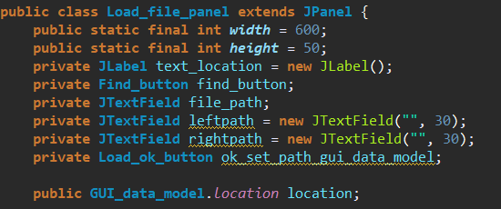
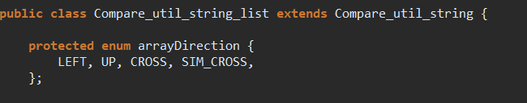
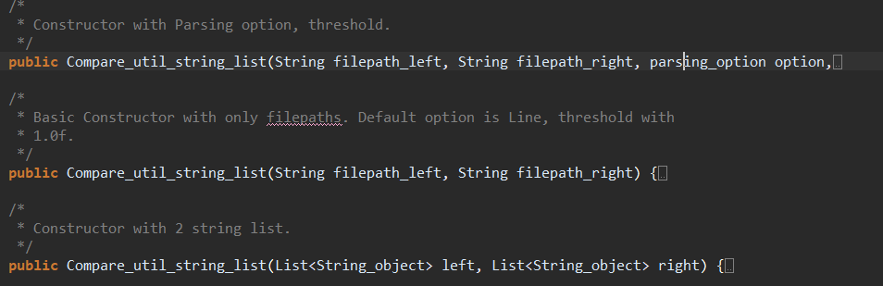
Object-oriented design
Encapsulation
Inheritance
Polymorphism

Slide 5
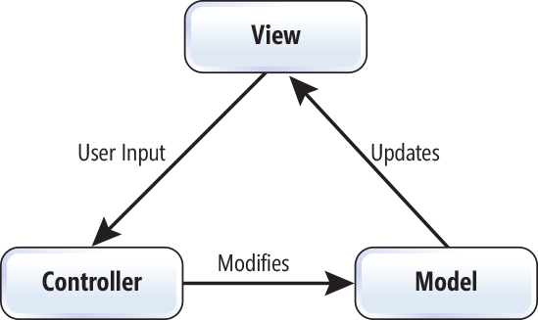
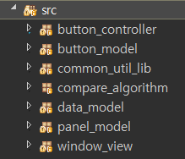
MVC model pattern
Divide program into three parts : Model , View, Controller
Each part has different role

Slide 6
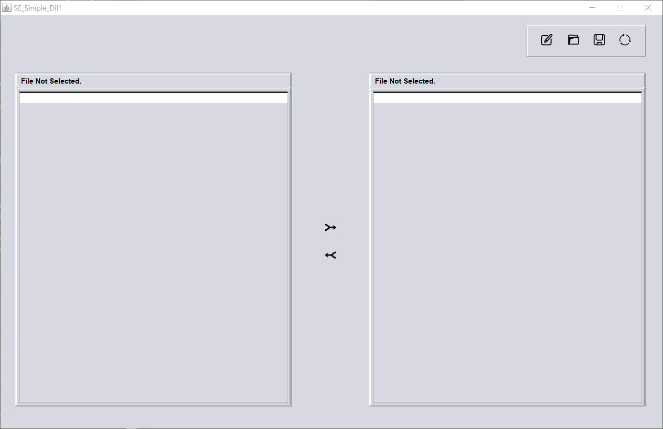
How to use
Main window
Pop up when user starts the program

Slide 7
How to use
BUTTONS
Edit Button : Enter edit mode
Load Button : Load text files
Save Button : Save text files
Refresh Button : Compare two text files
LRmerge Button : Merge left file to right file
RLmerge Button : Merge right file to left file

Slide 8
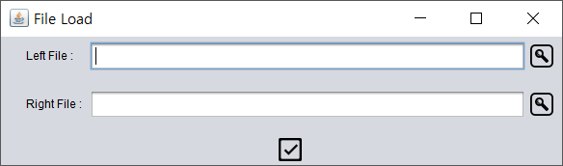
How to use
Pop up when user clicks load button

Slide 9
How to use
Pop up when user clicks load button
Find Button : Search text files

Slide 10
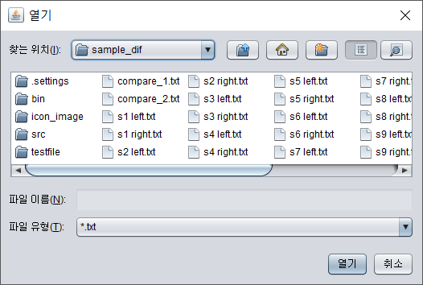
How to use
Pop up when user clicks load button
Find Button : Search text files
User can search text files

Slide 11
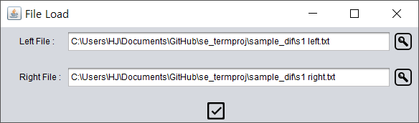
How to use
Pop up when user clicks load button
Find Button : Search text files
OK Button
User can search text files

Slide 12
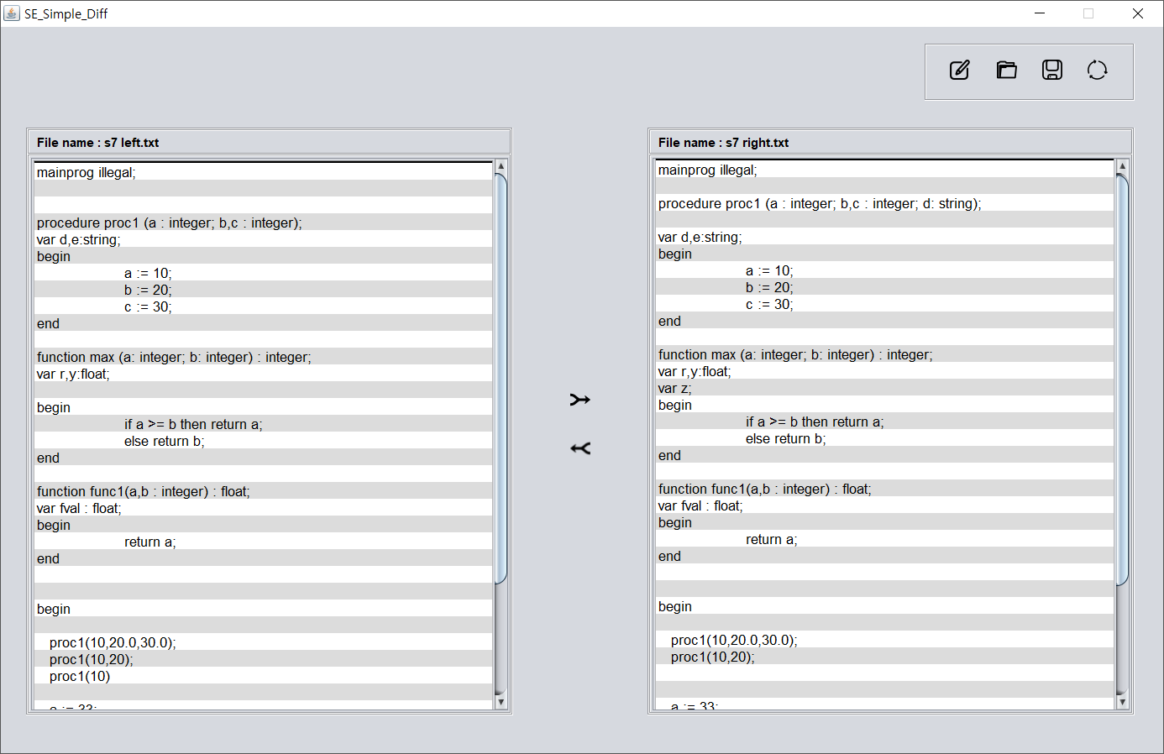
How to use
Main window (file loaded)

Slide 13
How to use
Main window (file loaded)
File name is shown

Slide 14
How to use
Main window (file loaded)
File name is shown
If the length of the text file is long , a scrollbar will appear.

Slide 15
How to use
Main window (file loaded)
File name is shown
If the length of the text file is long , a scrollbar will appear.
Now , user can compare two files by clicking Refresh button.

Slide 16
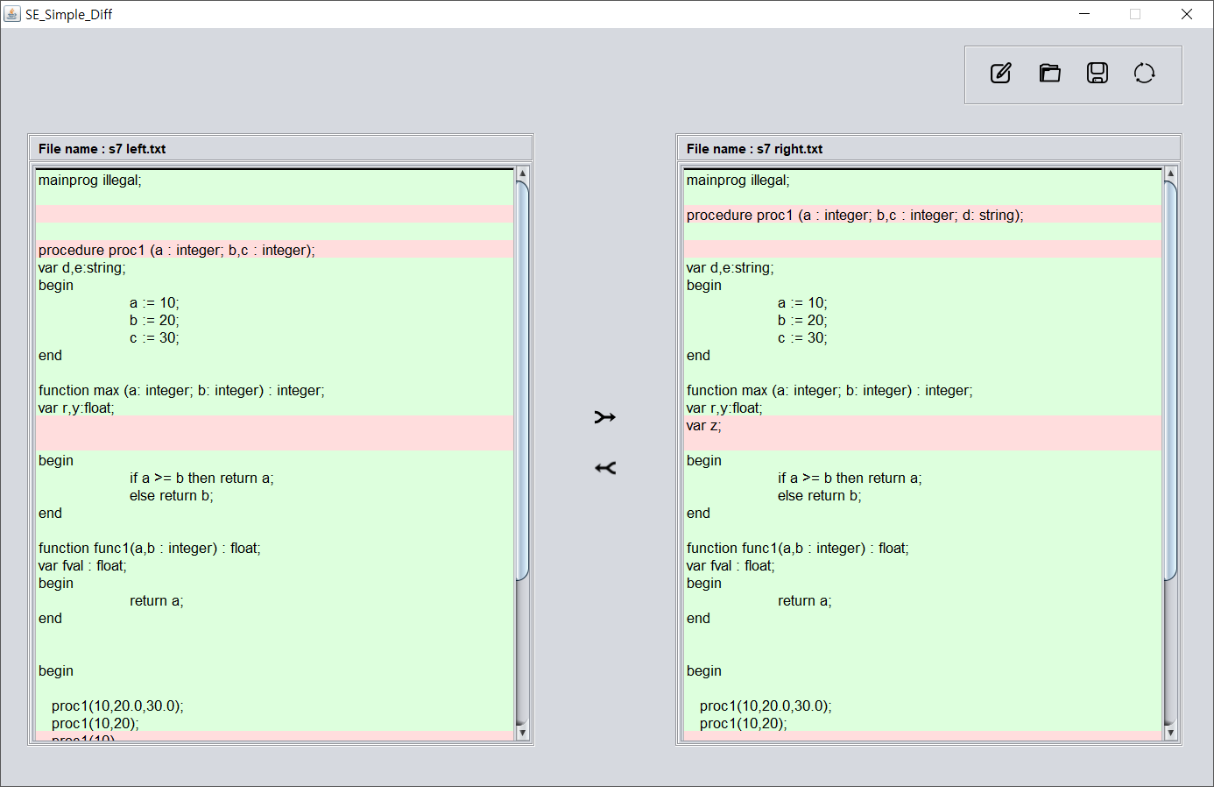
How to use
Same parts are colored with green
Different or missing parts are colored with red

Slide 17
How to use
Same parts are colored with green
Different or missing parts are colored with red
User can merge files by clicking merge buttons

Slide 18
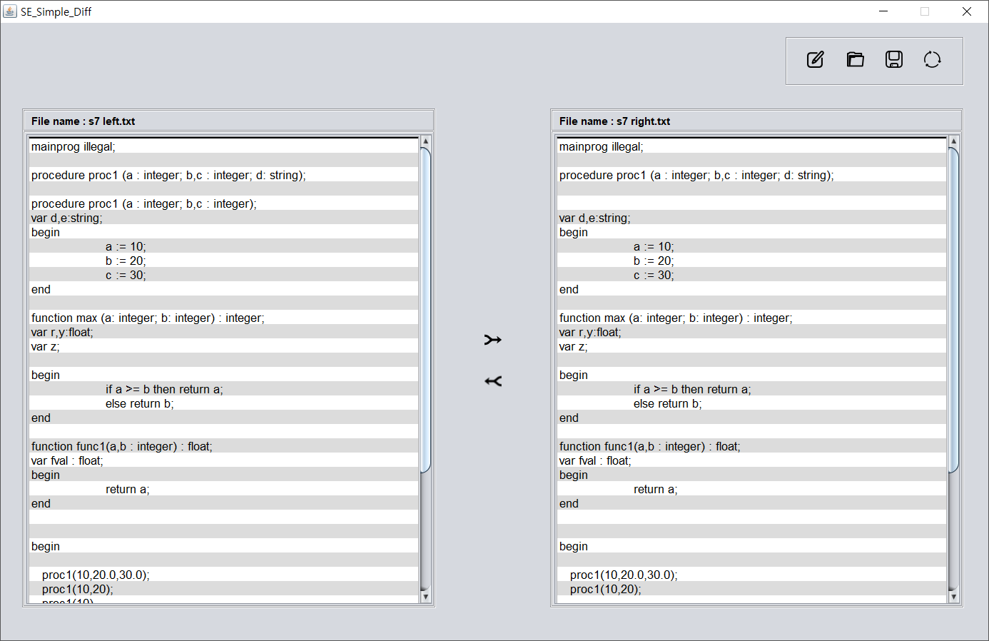
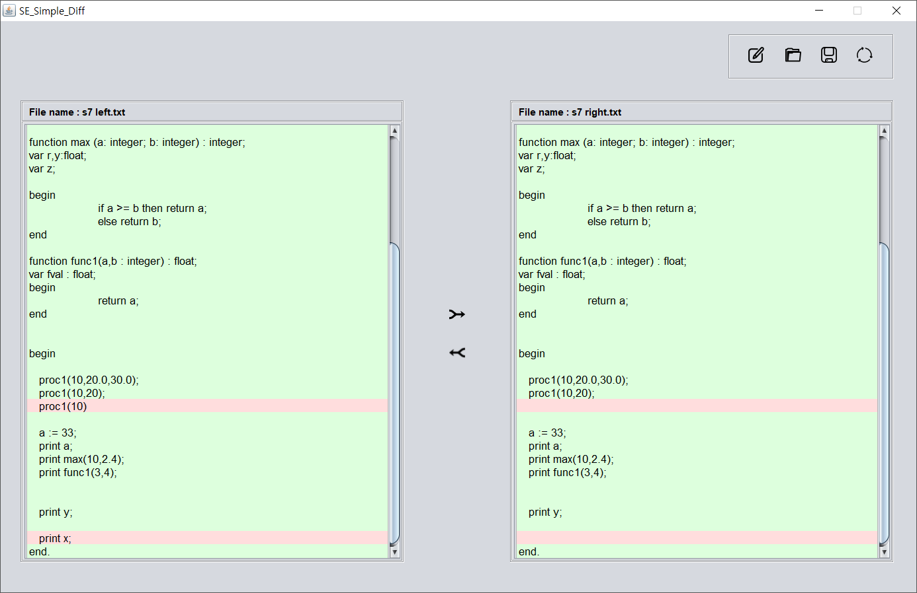
How to use
After clicking RLmerge button, you can see that Right to Left merge function is completed

Slide 19
How to use
After clicking RLmerge button, you can see that Right to Left merge function is completed
User can save the files by clicking Save button.

Slide 20
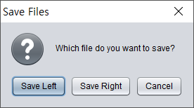
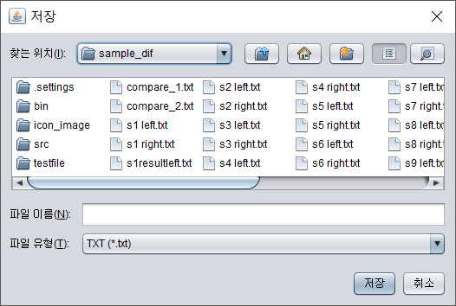
How to use
User can choose file to save.
User can overwrite the file or create a new file.

Slide 21
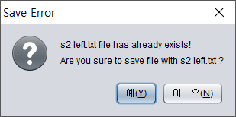
How to use
User can choose file to save.
User can overwrite the file or create a new file.

Slide 22
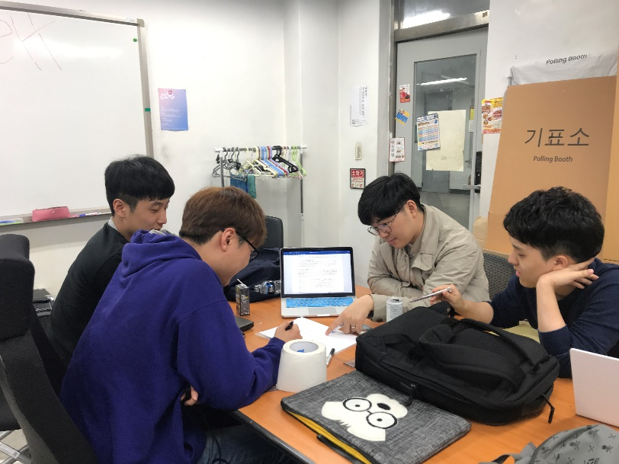
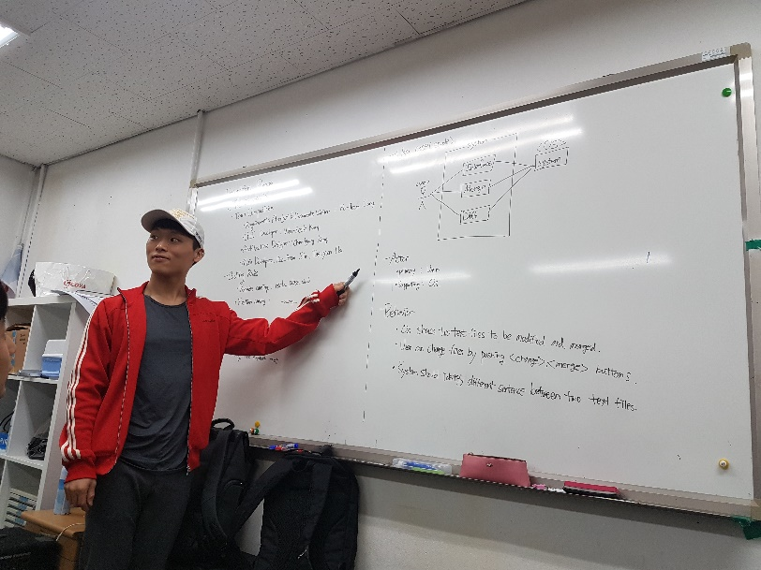
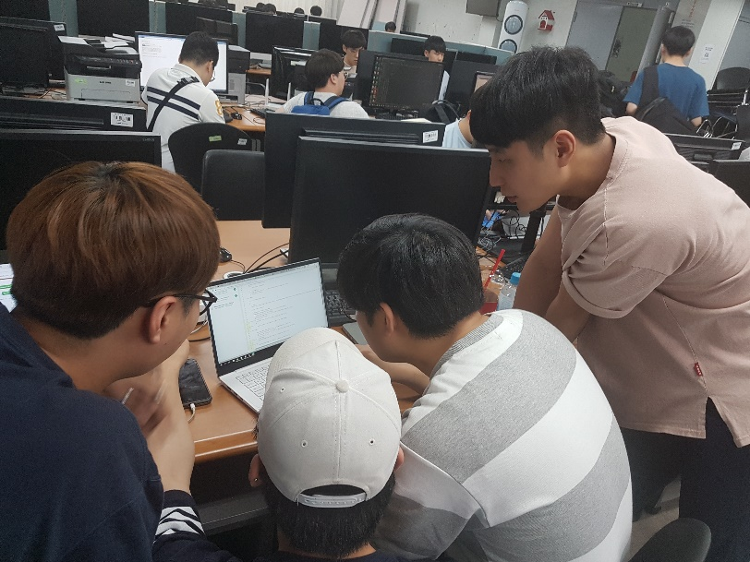
Project progress history
Several Phases & Several iterations
1~2 meetings per each week

Slide 23
Q & A

